Slide 1
Big Data Hadoop and Spark Developer

Slide 2
Deep Dive into Apache Spark Framework

Slide 3

Define Spark components and its architecture
Summarize Spark Deployment Modes
Work with PySpark Shell
Submit PySpark Job in a program
Work with Spark Web UI

Slide 4
Spark Components

Slide 5
Components of a Spark Project
Apache Spark is an alternative to Hadoop MapReduce that includes six components. These are:
Enables fault-tolerant processing of real time data streams
Provides tools like ML algorithms and other utilities
Perform and manipulate graph parallel computations
Provides capability to read from various structured data like CSV, Avro, Parquet
Enables R language users to leverage power of Apache Spark
Spark SQL
Spark Streaming
MLLib
GraphX
SparkR
Spark Core
Core engine of Apache Spark framework. Every other module in Spark is built on top of core module
Notes:
Trainer Notes:
Explain the diagram given in brief.

Slide 6
Components of a Spark Project
Spark Core and RDDs
It provides basic I/O, distributed task dispatching, and scheduling as the foundation.
RDDs can be created by applying coarse-grained transformations or referencing external datasets.
Spark SQL
As a component lying on the top of Spark Core, it introduces SchemaRDD, which can be manipulated.
It supports SQL with ODBC/JDBC server and command-line interfaces.

Slide 7
Components of a Spark Project
Spark Streaming
It leverages the fast-scheduling capability of Spark Core.
It ingests data in small batches and performs RDD transformations on them.
MLlib
It is a distributed machine learning framework built on top of Spark.
It is nine times faster than the Hadoop disk-based version of Apache Mahout.

Slide 8
Components of a Spark Project
GraphX
It is a distributed graph processing framework built on top of Spark.
It provides an API and an optimized runtime for the Pregel abstraction.
SparkR
It provides a simple interface for using Apache Spark from R.
It provides a distributed data frame implementation for huge datasets.
It supports operations like selection, filtering, and aggregation.

Slide 9
Category of Spark Components
PROGRAMMING
Scala
Java
Python
R
LIBRARY
Spark SQL
Spark Streaming
MLLib
GraphX
ENGINE
Spark Core
MANAGEMENT
Apache YARN
Spark Standalone
Apache Mesos
STORAGE
Local
HDFS
NoSQL DBs
Notes:
Trainer Notes:
Explain each component in brief.

Slide 10


Application of In-Memory Processing
In column-centric databases, similar pieces of information can be stored together. The working of in-memory processing can be explained as below:
The entire information is loaded into memory, eliminating the need for indexes, aggregates, optimized databases, star schemas, and cubes.
Compression algorithms are used by most in-memory tools, thereby reducing the in-memory size.
Notes:
Trainer Notes:
Explain each mode in detail.

Slide 11


Application of In-Memory Processing
The analysis of data can be flexible in size and can be accessed within seconds by concurrent users with excellent analytics potential.
It is possible to access visually rich dashboards and existing data sources.
Querying the data loaded into memory is different from caching.
Notes:
Trainer Notes:
Explain each mode in detail.

Slide 12
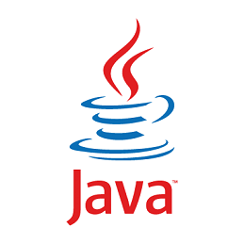




Language Flexibility in Spark
Spark is popular for its performance benefits over MapReduce. Another important benefit is language flexibility, as explained below.
Support for various development languages
Spark supports popular development languages like Java, Scala, and Python and will support R.
Capability to define functions in-line
With the temporary exception of Java, a common element in these languages is that they provide methods to express operations using lambda functions and closures.

Slide 13
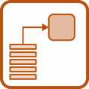


Hadoop Ecosystem vs. Spark
Every type of data processing can be done using Spark that is executed in Hadoop. They are:
Batch Processing: Spark batch can be used over Hadoop MapReduce.
Structured Data Analysis: Spark SQL can be used with SQL.
Machine Learning Analysis: MLlib can be used for clustering, recommendations, and classification.
Interactive SQL Analysis: Spark SQL can be used over Stringer, Tez, or Impala.
Real-time Streaming Data Analysis: Spark streaming can be used over specialized libraries like Storm.

Slide 14
Spark Architecture

Slide 15

Spark Architecture
The components of the Spark execution architecture are:
Spark-submit script: Used to launch applications on a cluster; can use all cluster managers through a uniform interface
Spark applications: Run as independent sets of processes on a cluster and are coordinated by the SparkContext object in the driver program
Cluster managers: Supported cluster managers are Standalone, Apache Mesos, and Hadoop YARN
Spark’s EC2 launch scripts: Make launching a standalone cluster easy on Amazon EC2
Spark Driver Program
HDFS
Spark Scheduler
NoSQL
Mesos/YARN
Worker node running transformations
Worker node running transformations
Notes:
Trainer Notes:
Explain in detail.

Slide 16
Working of Apache Spark Architecture
The following diagram depicts the basic Apache Spark architecture:
Worker Node
Executor
Cache
Task
Task
Driver Program
Spark Context
Cluster
Manager
Worker Node
Executor
Cache
Task
Task
Notes:
Trainer Notes:
Explain in detail.

Slide 17
Working of Apache Spark Architecture
The components of the Spark execution architecture are explained below:
1
Driver Program
It is the execution point of the program. It creates SparkContext to schedule job execution and negotiates with the cluster manager.
2
SparkContext object in Driver Program
It helps in coordinating with all the distributed processes and allows resource allocation.
3
Cluster Manager
It provides executors for the execution of code.
Notes:
Trainer Notes:
Explain in detail.

Slide 18
Working of Apache Spark Architecture
The components of the Spark execution architecture are explained below:
4
Executors
It uses cache slots to keep data in memory, and task slots are Java threads that run the code. Executors run tasks scheduled by the driver.
5
Worker Node
They are the slave nodes that execute the tasks.
Notes:
Trainer Notes:
Explain in detail.

Slide 19
Spark Cluster in Real World

Slide 20




Running Spark in Different Modes
The different deployment modes of Spark are:
Can be launched manually by using launching scripts or starting a master and workers, which are used for development and testing
Has advantages like scalable partitioning among different Spark instances and dynamic partitioning between Spark and other frameworks
Has all the parallel processing and benefits of the Hadoop cluster
Has key-value pair benefits of Amazon
Notes:
Trainer Notes:
Explain each mode in detail.

Slide 21
Deployment Modes: YARN
Two deployment modes can be used to launch Spark applications on YARN.
Client mode
Cluster mode
Notes:
Trainer Notes:
Explain each mode in detail.

Slide 22
Deployment Modes: YARN
Client mode
/bin/spark-submit --class org.apache.spark.examples.SparkPi --master yarn --deploy-mode client /path/to/examples.jar
Cluster mode
/bin/spark-submit --class org.apache.spark.examples.SparkPi --master yarn --deploy-mode cluster /path/to/examples.jar
Notes:
Trainer Notes:
Explain each mode in detail.

Slide 23
Client Mode: YARN
The architecture of YARN in client mode is depicted in the diagram below.
YARN Container
Client
Application
Commands
Spark Application Master
Resource
Request or Reply
YARN Resource Manager
Spark Driver
Issue Application Commands
Launch Spark Executor
YARN Node Manager
YARN Container
YARN Container
Spark Executor
Spark Executor
Spark Task
Notes:
Trainer Notes:
Explain each mode in detail.

Slide 24
Client Mode: YARN
The Spark Driver runs on the host from where the job is submitted in client mode.
The Application Master’s job is to request resources (executor containers)
from YARN.
The client communicates with the containers to coordinate the work after they start.
Notes:
Trainer Notes:
Explain each mode in detail.

Slide 25
Cluster Mode: YARN
The architecture of YARN in cluster mode is depicted in the diagram below.
YARN Container
Client
Application
Commands
Spark Application Master
Resource
Request or Reply
YARN Resource Manager
Spark Driver
Issue Application Commands
Launch Spark Executor
YARN Node Manager
YARN Container
YARN Container
Spark Executor
Spark Executor
Spark Task
Notes:
Trainer Notes:
Explain each mode in detail.

Slide 26
Cluster Mode: YARN
Spark Driver runs in the Application Master on a cluster machine.
A single process in a YARN container is responsible for both driving the application and requesting resources from YARN.
The client that launches the application does not run for the lifetime of the application.
Notes:
Trainer Notes:
Explain each mode in detail.

Slide 27
Introduction to PySpark Shell

Slide 28

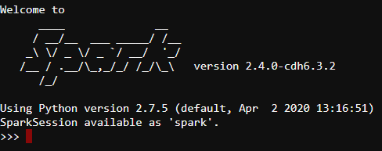
Spark Shell
The Spark Shell provides interactive data exploration (REPL).
It is used for the execution of PySpark statements.
Spark Shell is available for Scala, Python, and R.
The pyspark command is used to launch Spark from the Python shell, which is also known
as PySpark.
PySpark

Slide 29
SparkContext
It is the main entry point of Spark API.
Every Spark application requires a SparkContext.
Spark Shell provides a preconfigured SparkContext called sc.
A driver program starts when we execute any Spark application.
The operations are then executed by the driver program inside the executors on worker nodes.
PySpark

Slide 30
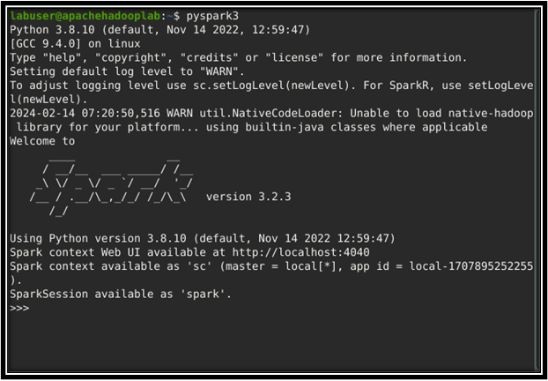
PySpark Shell in Simplilearn Lab

Slide 31
Submitting PySpark Job

Slide 32
Submitting PySpark Job
The spark-submit command submits PySpark jobs on the spark cluster.
Syntax:
spark-submit \
--master yarn \
--deploy-mode cluster \
example123.py

Slide 33
Submitting PySpark Job
The common options used are:
--class
The entry point for an application
04
03
--master
The master URL for the cluster
02
--deploy-mode
Whether the driver should be deployed on the worker nodes
01
--conf
Arbitrary Spark configuration property in key=value format
Notes:
Trainer Notes:
Explain all the options with example
Arbitrary Spark configuration property in key=value format. For example: --conf <key>=<value> --conf <key2>=<value2>

Slide 34
Execution of Spark Jar File: Example
This example illustrates how to execute a Spark jar file with the spark-submit command. Before submitting the jar, users should ensure that the application has a total of 8 cores.
Run the application locally on 8 cores
./bin/spark-submit \
--class org.apache.spark.examples.SparkPi \
--master local[8] \
/path/to/example123.jar \
100
Notes:
Trainer Notes:
Explain how to run an application locally on 8 cores.

Slide 35
Execution of Spark Jar File: Example
This example shows how to execute a Spark jar file with the spark-submit command. Before submitting the jar, it must ensure that the application is deployed in client mode. The deployment mode is specified using the –deploy-mode property.
Run on a Spark standalone cluster in client deploy mode
./bin/spark-submit \
--class org.apache.spark.examples.SparkPi \
--master spark://207.184.161.138:7077 \
--executor-memory 20G \
--total-executor-cores 100 \
/path/to/examples.jar \
1000
Notes:
Trainer Notes:
Explain how to run an application on a client deploy mode.

Slide 36
Execution of Spark Jar File: Example
This example illustrates how to run a Spark jar file with the spark-submit command. Ensure that the application is in cluster deploy mode with the supervise flag enabled before submitting the jar.
Run on a Spark standalone cluster in cluster deploy mode with supervise
./bin/spark-submit \
--class org.apache.spark.examples.SparkPi \
--master spark://207.184.161.138:7077 \
--deploy-mode cluster \
--supervise \
--executor-memory 20G \
--total-executor-cores 100 \
/path/to/examples.jar \
1000
Notes:
Trainer Notes:
Explain how to run an application on a Spark standalone cluster in cluster deploy mode with supervise.

Slide 37
Execution of Spark Jar File: Example
This example shows how to execute a Spark jar file with the spark-submit command. While submitting the jar, users must ensure that the application is running on a YARN cluster in cluster deploy mode.
Run on a YARN cluster in cluster deploy mode
export HADOOP_CONF_DIR=XXX
./bin/spark-submit \
--class org.apache.spark.examples.SparkPi \
--master yarn \
--deploy-mode cluster \
--executor-memory 20G \
--num-executors 50 \
/path/to/examples.jar \
1000
Notes:
Trainer Notes:
Explain how to run an application on a YARN cluster in cluster deploy mode.

Slide 38
Execution of Spark Jar File: Example
This example illustrates how to run a spark jar file with the spark-submit command. One must ensure that the application is submitted on a Spark standalone cluster while submitting the jar.
Run a Python application on a Spark standalone cluster
./bin/spark-submit \
--master spark://207.184.161.138:7077 \
examples/src/main/python/pi.py \
1000
Notes:
Trainer Notes:
Explain how to run Run a Python application on a Spark standalone cluster

Slide 39
Execution of Spark Jar File: Example
This case illustrates how to execute a spark jar file with the spark submit command. While submitting the jar, users must ensure that the application is running on a Mesos cluster in cluster deploy mode with the supervise flag.
Run on a Mesos cluster in cluster deploy mode with supervise
./bin/spark-submit \
--class org.apache.spark.examples.SparkPi \
--master mesos://207.184.161.138:7077 \
--deploy-mode cluster \
--supervise \
--executor-memory 20G \
--total-executor-cores 100 \
http://path/to/examples.jar \
1000
Notes:
Trainer Notes:
Explain how to run Run on a Mesos cluster in cluster deploy mode with supervise

Slide 40
Spark Web UI

Slide 41
Spark Web UI
Apache Spark provides several web user interfaces that can be used to monitor the status and resource consumption of a Spark cluster.
Worker web UI
Master web UI
Apache Spark UIs:
Application web UI

Slide 42
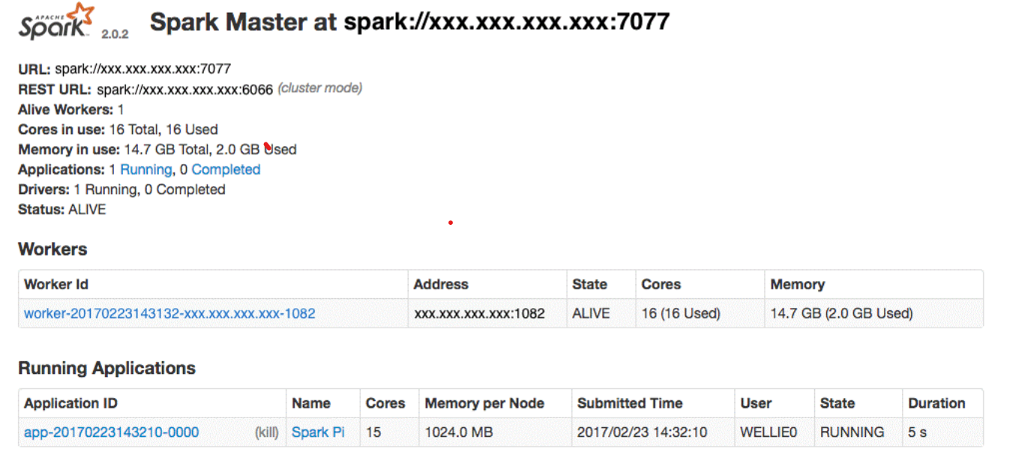
Master Web UI
It is used to monitor CPU and memory resources that are allotted to the Spark cluster and for
each application.
Spark master URL is : spark://localhost:7077
Total number of cores in cluster is 16
Total memory used is 14.7 GB
Number of running applications is 1

Slide 43
Master Web UI
It provides an overview of the Spark cluster and displays the following information:
Master URL and REST URL
Active and completed drivers
CPUs and memory available to the Spark cluster
Active and completed applications
Number of applications running
Notes:
Trainer Notes:
Explain all the information which Master Web UI provides
Master URL and Resr URL
2. CPUs and memory available to the Spark cluster
3. Information about the active and completed applications, such as their status, allotted resources, and duration.
4. Information about the active and completed drivers, such as their status and allotted resources

Slide 44
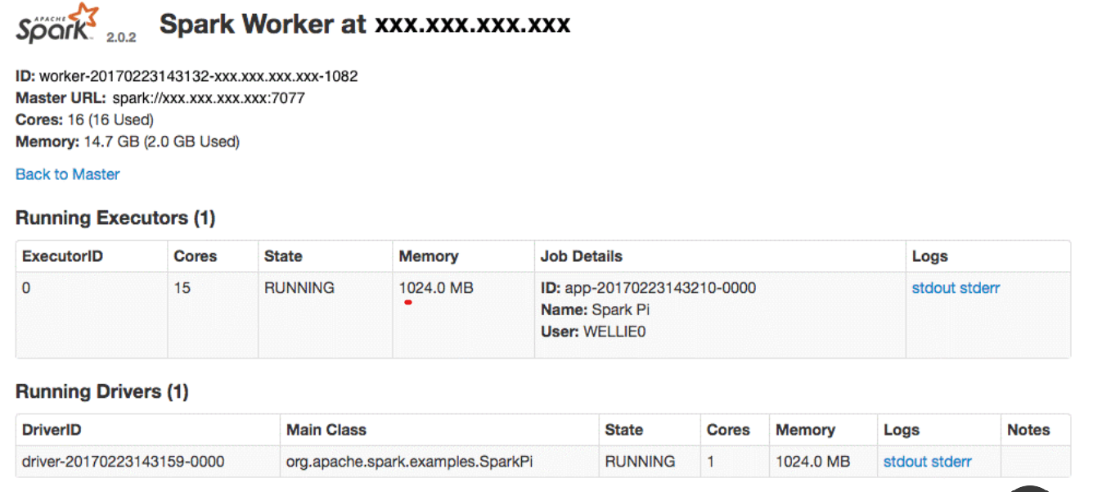
Worker Web UI
The Worker Web UI provides information about the executors and applications.
Spark Worker UI
Total number of running executors is 1
One application is running
Notes:
Explanation:
This is Spark Worker UI.
Total no. of running executors is 1.
There is one application running (SparkPi)

Slide 45


Worker Web UI
The Worker Web UI provides an overview of the executors and drivers that are spawned by the worker process.
The Web UI can see the number of executors that are currently running, and the number of resources allotted to them.
It displays the status of the
allotted resources.

Slide 46
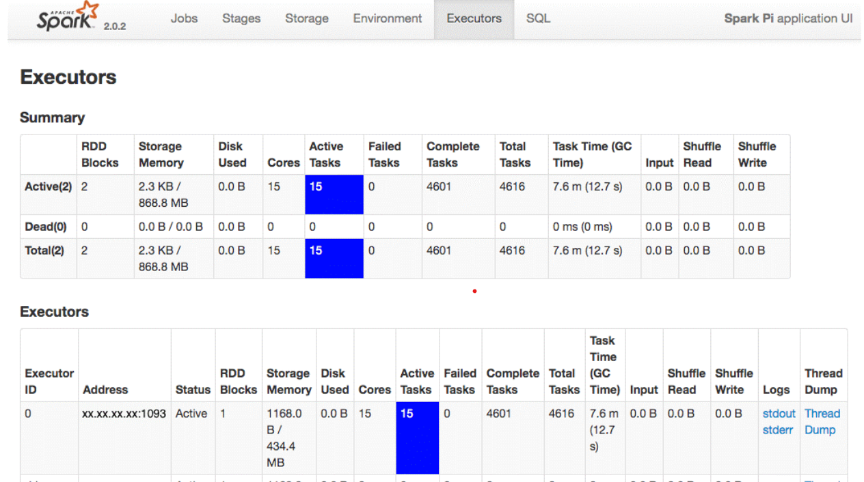
Application Web UI
The Application Web UI provides information about the Executors.
2 active executors with 15 cores and 15 active tasks
Total completed tasks are 4601
Total tasks are 4616
Notes:
Explanation:
This UI provides information about the Executors.
There are 2 active executors having 15 cores and having 15 active tasks.
Total tasks are 4616.
Total completed tasks are 4601.

Slide 47
Application Web UI
1
Each Spark application launches its instance of the web UI.
The Application Web UI provides a wealth of information about the Spark application and can be a useful tool to debug the application.
2

Slide 48
Assisted Practice:Creating a Scala Job for Apache Spark
Duration: 10 Minutes
Problem Scenario:
Andrew, employed as a data engineer at a bank, has been tasked with evaluating the performance of a Spark application in cluster and client modes. He is asked to submit the same job in both modes and conduct a comparative analysis of the outcomes.
Objective: To showcase how to deploy a Spark job effectively in client and cluster modes-
Refer assisted practice-Creating a Scala Job for Apache Spark
Notes:
Trainer Notes:
Perform each step along with the learner.

Slide 49
Spark supports popular development languages like Java, Scala, R, and Python.
In client mode, the Spark driver runs on the host from where the job is submitted.
In cluster mode, the Spark Driver runs in the Application Master on a cluster machine.
Apache Spark provides several web user interfaces that we can
use to monitor the status and resource consumption of the
Spark cluster.

Slide 51
Which of the following are the components of the Spark project?
1
Spark Core and RDDs
Spark SQL
Spark Streaming
All of the above

Slide 52
Which of the following are the components of the Spark project?
1
Spark Core and RDDs
Spark SQL
Spark Streaming
All of the above
D
Spark Core and RDDs, Spark SQL, and Spark Streaming are some of the components of the Spark project.

Slide 53
The Spark driver runs on the host from where the job is submitted. Which mode
is being referred to?
2
Client Mode
Cluster Mode
Standalone Mode
Mesos

Slide 54
The Spark driver runs on the host from where the job is submitted. Which mode
is being referred to?
2
Client Mode
Cluster Mode
Standalone Mode
Mesos
A
The driver is launched directly within the spark-submit process in client mode, which acts as a client to the cluster.
The input and output of the application are attached to the console.

Slide 55
Which of the following are the supported Cluster Managers?
3
Standalone
Apache Mesos
Hadoop Yarn
All of the above

Slide 56
Which of the following are the supported Cluster Managers?
3
Standalone
Apache Mesos
Hadoop Yarn
All of the above
D
Standalone, Apache Mesos, and Hadoop Yarn are all supported Cluster Managers.

Slide 57
Assume you want to run a Spark job on your production server to collect data from
all bike stations with more than 10 vehicles at any given moment. This job will be
sent to YARN via:
4
Spark-shell console
SparkR way
Jar file using spark-submit
Executable file via spark-shell

Slide 58
Assume you want to run a Spark job on your production server to collect data from
all bike stations with more than 10 vehicles at any given moment. This job will be
sent to YARN via:
4
Spark-shell console
SparkR way
Jar file using spark-submit
Executable file via spark-shell
C
The spark-submit script in Spark's bin directory is used to launch applications on a cluster. It can use all the Spark’s supported cluster managers through a uniform interface so each application need not be configured individually.

Slide 59
Thank You

